Slide 1
Learning Supports

Slide 2
Purpose
Provide a brief overview of Learning Supports
Demonstrate the relationship between RtI and Learning Supports
No School Board Action is required

Slide 3
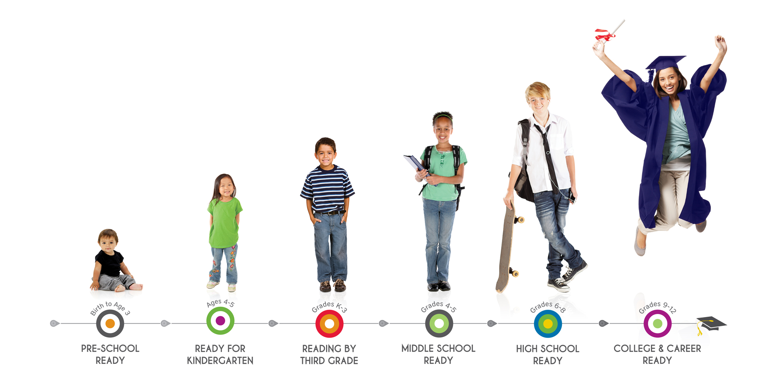
Pathways to Graduation
…is a comprehensive framework that identifies key milestones students need to meet in order to be prepared for the next
level of study, graduate on time, and enter
college or a career with the necessary
skills to be successful.
Notes:
There is more that goes into measurements of success than academic indicators. Many barriers can stand in the way of success along the pathways.

Slide 4
Evolution of RtI in BPS
2007-2008 School Year: Pilot Sites Identified
2008-2009 School Year: ADSIS funded teachers, PBIS
2009-2010 School Year: MN Reading Corp
2010-2011 School Year: Additional sites added
2011-2012 School Year: Deeper implementation
2012-2013 School Year: Audit of RTI implementation at each site

Slide 5
RESPONSE TO INTERVENTIONS EVOLVING TO LEARNING SUPPORT
Systems for care and treatment for few
For Few
For Some
Systems for early interventions for SOME
For All
Systems for promoting healthy development and preventing issues for ALL
Tiered
Academic
Interventions
Tiered
Academic & Behavior
Interventions
Tiered Classroom Based Interventions

Slide 6
Community Supports
RESPONSE TO INTERVENTIONS EVOLVING TO LEARNING SUPPORT
Crisis Assistance and Prevention
Family Engagement in Learning
Student and Family Interventions
Support for Transitions
Classroom-Based Approaches
Full Continuum of interventions in all areas

Slide 7
Learning Supports
LEARNING SUPPORTS is a framework of systems and structures that aligns resources and support to respond to student need in order to ensure success along the pathways.

Slide 8
Our work:
is to facilitate the process of building, maintaining, monitoring, and adjusting the framework to best address student barriers to learning and engagement.

Slide 9
This is accomplished by:
Building on what’s going well
Enhancing capacity for promoting promising practices
Escaping old ideas that limit student success
Establishing new approaches that are effective, sustained and replicated

Slide 10
Learning Supports…
Moves student supports away from reacting to problems toward system development with a strong emphasis on prevention and early intervention.

Slide 11
What the best and wisest parent wants for his or her own child, that must the community want for all of it’s children. Anything else would be narrow and unlovely.
                John Dewey

Slide 12
What percent of your students come ready and able to learn everyday?

Slide 13
What are the barriers?
At your table talk about some of the barriers to learning that affect your students learning and your teaching.
Write some the barriers on sticky notes

Slide 14
School systems are not responsible for meeting every need of their students, but…
  When the need directly affects learning, the school must meet the challenge.
                Carnegie Task Force on Education

Slide 15
Next Steps
Mapping
Teams

Slide 16
Classroom-Based Approaches
Opening the classroom door to bring supports in (e.g. peer tutors, volunteers, aids trained to work with students in need, resource teachers and student support staff work in the classroom as part of the teaching team)
Redesigning classroom approaches to enhance teacher capability to prevent and handle problems and reduce need for out-of-class referrals (e.g. personalized instruction; special assistance as necessary; developing small-group and independent learning options; reducing negative interactions and over reliance on social control; expanding the range of curricular and instructional options and choices; systematic use of prereferral interventions)
Enhancing and personalizing professional development (e.g. creating a Learning Community for teachers; ensuring opportunities to learn through co-teaching, team teaching, and mentoring; teaching intrinsic motivational concepts and their application to schooling)
Curricular enrichment and adjunct programs (e.g. varied enrichment activities that are not tied to reinforcement schedules; visiting scholars from the community)
Classroom and school-wide approaches used to create and maintain a caring and supportive climate

Slide 17
Support for Transitions
Welcoming and social support programs for newcomers (e.g. welcoming signs, materials, and initial receptions; peer buddy programs for students, families, staff, and volunteers)
• Daily transition programs for (e.g. before school, breaks, lunch, after school)
• Articulation programs(e.g. grade-to-grade – new classrooms, new teachers; elementary to junior high; junior high to high school; high school to ALC or ALC to high school; in and out of special education programs)
• Summer or inter-session programs (e.g. catch-up, recreation, and enrichment programs)
• School-to-career / higher education (e.g. counseling, pathway, and mentor programs; broad involvement of stakeholders in planning for transitions; students, staff, home, police, faith groups, recreation, business, higher education)
• Broad involvement of stakeholders in planning for transitions (e.g. students, staff, home, police, faith groups, recreation, business, higher education)
• Capacity building to enhance transition programs and activities

Slide 18
Family Engagement in Learning
Addressing specific support and learning needs of families (e.g. support services for those in the home to assist in addressing basic survival needs and obligations to children; adult education classes to enhance literacy, job skills, ESL language, and citizenship preparation)
Improving mechanisms for communicating and connecting to school and home (e.g. opportunities at school for family networking and mutual support, learning, recreation, enrichment, and for family members to receive special assistance and to volunteer to help; phone calls and/or email from teacher and other staff with good news; frequent and balanced conferences – student-led when feasible; outreach and attract hard-to-reach families – including dropouts)
Involving homes in student decision making (e.g. families prepared for involvement in program planning and problem solving)
Enhancing home support for learning and development (e.g. family literacy; family homework projects; family field trips)
Recruiting families to strengthen school and community (e.g. volunteers to welcome and support new families and help in various capacities; families prepared for involvement in school governance)
Capacity building to enhance home involvement

Slide 19
Community Support
• Planning and implementing outreach to recruit a wide range of community resources (e.g. public and private agencies; colleges and universities; local residents; artists and cultural institutions, businesses, and professional organizations; service, volunteer, and faith-based organizations; community policy and decision makers)
• Systems to recruit, screen, prepare, and maintain community resource involvement (e.g. mechanisms to orientate and welcome, enhance the volunteer pool, maintain current involvement, enhance a sense of community)
• Reaching out to students and families who don’t come to school regularly – including truants and drop outs
Connecting school and community efforts to promote child and youth development and a sense of community
Capacity building to enhance community involvement and support (e.g. policies and mechanisms to enhance and sustain school-community involvement, staff/stakeholder development on the value of community involvement social marketing

Slide 20
Crisis Assistance and Prevention
• Ensuring immediate assistance in emergencies so students can resume learning
• Providing follow-up care as necessary (e.g. brief and long-term monitoring)
• Forming a school-focused Crisis Team to formulate a response plan and take leadership for developing prevention programs
• Mobilizing staff, students, and families to anticipate response plans and recovery efforts
• Creating a caring and safe learning environment (e.g. developing systems to promote healthy development and prevent problems; bullying and harassment abatement programs)
• Working with neighborhood schools and community to integrate planning for response and prevention
Capacity building to enhance crisis response and prevention (e.g. staff and stakeholder development, enhancing a caring and safe learning environment)

Slide 21
Student and Family Interventions
Providing extra support as soon as a need is recognized and doing so in the least disruptive ways (e.g. prereferral interventions in classrooms; problem solving conferences with parents; open access to school, district, and community support programs)
• Timely referral interventions for students and families with problems based on response to extra support (e.g. indentification/screening process, assessment, referrals, and follow-up – school-based, school-linked)
• Enhancing access to direct interventions for health, mental health, and economic assistance (e.g. school-based, school-linked, and community-based programs and services)
• Care monitoring, management, information sharing, and follow-up assessment to coordinate individual interventions and check whether referrals and services are adequate and effective
• Mechanisms for resource coordination and integration to avoid duplication, fill gaps, garner economies of scale, and enhance effectiveness (e.g. braiding resources from school-based and linked interveners, feeder pattern/family of schools, community-based programs; linking with community providers to fill gaps.
• Enhancing stakeholder awareness of programs and services
Capacity building to enhance student and family assistance systems, programs, and services

