Slide 1
A Comprehensive System of Learning Supports: Strengthening Family and Community Engagement
Scholastic Family and Community Engagement Symposium
October 2, 2012
Dr. Merrianne Dyer, Superintendent, Gainesville City Schools
Dr. Rhonda Neal Waltman, Former Asst. Superintendent, Mobile, AL

Slide 3
COLLABORATION
“One of the most important, cross-cutting social policy perspectives to emerge in recent years is an awareness that no single institution can create all the conditions that young people need to flourish….”
(Melaville and Blank, 1993)

Slide 4
COLLABORATION
WHAT WE DO NOT WANT IS…
Poorly implemented collaborations:
Can end up being another reform effort that promised a lot, did little good, and even did some harm
Makes the concern about widespread fragmentation of school/community interventions even worse if we stop moving forward

Slide 5
OUR BELIEFS
We believe that the collaborative actions of students, parents, community, and the school system are the determining factors in the success of our students.
We believe that high expectations for EVERYONE drives success.
We believe that continuous learning occurs best in a safe, nurturing, and stimulating environment.

Slide 6
What barriers prevent literacy development?
Cultural and/or language disconnects
Different priorities
Expectations of roles and responsibilities are not connected and/or were not modeled in their childhood
Negative experiences with school or authority

Slide 7
A snapshot of Gainesville:
Gainesville, GA, is located 60 miles northeast of Atlanta; a mid-size urban district
Title I School District – 80% poverty rate
Charter School District- all schools are charter schools
One of the fastest changing demographics in the country:
54% Hispanic 22% African American, 20% Caucasian, 4% Asian and Multi-Ethnic/Racial
38% of students are English Language Learners
11% are Students with Disabilities
13% are identified as Gifted
7, 172 students
10% of students pay tuition to attend GCSS

Slide 8
To help achieve student and school goals, Gainesville City Schools uses a Comprehensive System of Learning Support Framework
Developed by Drs. Howard Adelman and Linda Taylor, UCLA Center for Mental Health in Schools. Based on more than 30 years of research and implementation.
Led by UCLA, Scholastic Classroom and Community Group and AASA, the district is part of a Learning Supports Lead District Collaborative along with Stillwater, MN and Grant Parish, LA
l

Slide 9
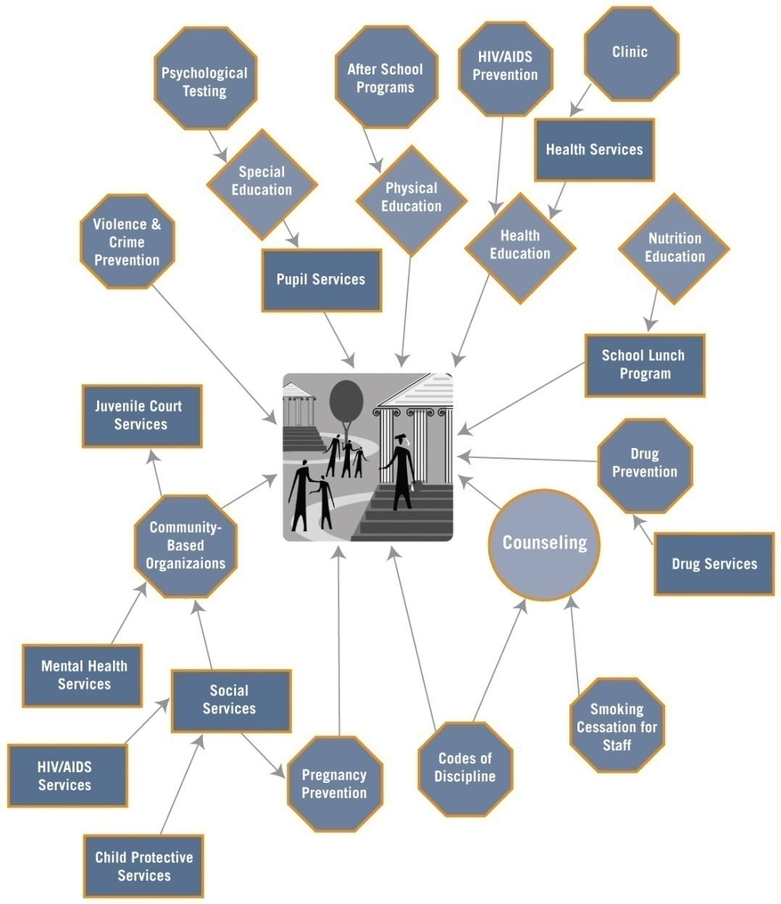
A Traditional Approach to Learning Supports
Fragmented
Policy
Fragmented
Practices

Slide 10
MOVING IN NEW DIRECTIONS
A unified approach to school improvement planning includes:
Instruction: Best practices for effective instruction
Management: Best practices for site administration
Learning Supports: Coalescing of resources to address barriers to learning
Notes:
10

Slide 11
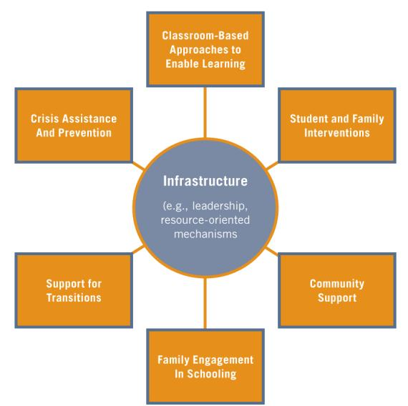
MOVING IN NEW DIRECTIONS
Learning Supports Content Arenas
Notes:
11

Slide 12
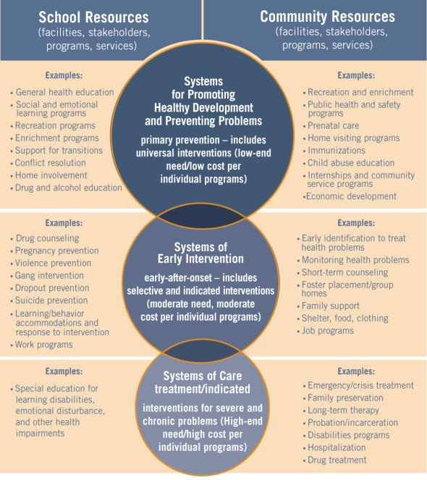
Continuum of Interventions

Slide 13
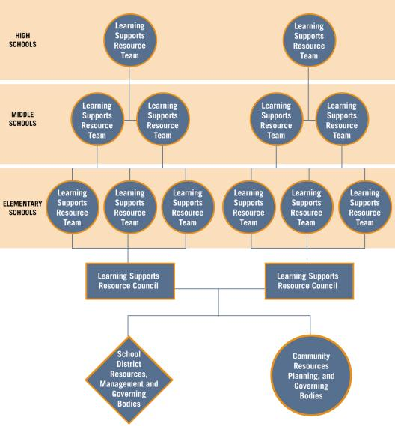
MOVING IN NEW DIRECTIONS
Comprehensive Learning Supports System
Connecting Resources Across:
Feeder Pattern
District
Community-Wide
Notes:
13

Slide 14
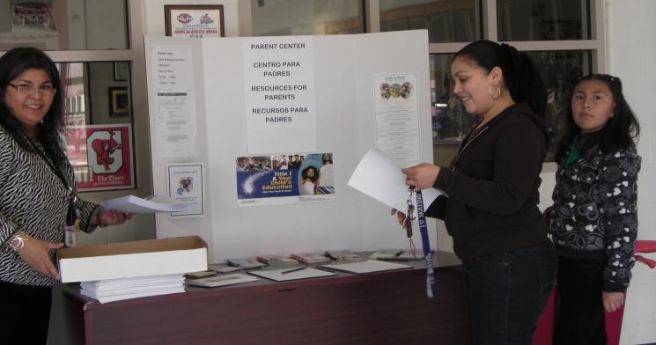
The Gainesville Learning Supports Team
Parent Coordinators, Social Workers, Counselors, Assistant Principals, SPED and ELL Directors, Board Representative, Community Agencies Representatives, Housing Authority Officials…working together.

Slide 15
Resource Mapping: Analyze District, School, and Community Data
District and school level personnel examine the barriers to learning as identified in the data
District, community, parents, and school level personnel map the resources available
Eliminate redundancy and duplication
Identify areas for collaborating and leveraging funds

Slide 16
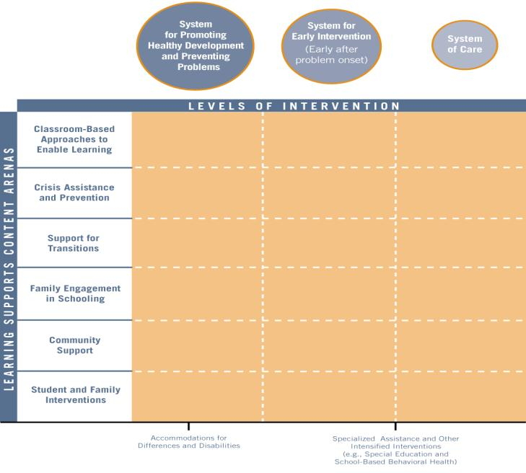
Content Arenas + Continuum=
Framework for a Comprehensive System of Learning Supports

Slide 17
Resource Mapping “A-ha” Learnings:
Frequent family requests and existing learning supports ….
Career preparation for children
Job Fairs or employment information for themselves
Tutoring assistance
Extracurricular activities information
After school program information
Financial planning
Health care information
Migrant education
Immigration – Graduation -Post secondary options
Key: Place literacy development within each workshop

Slide 18
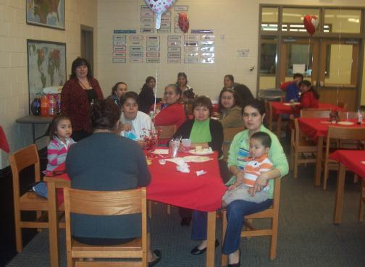
Scholastic’s “READ AND RISE” GAVE US A PLATFORM FOR FAMILY ENGAGEMENT

Slide 19
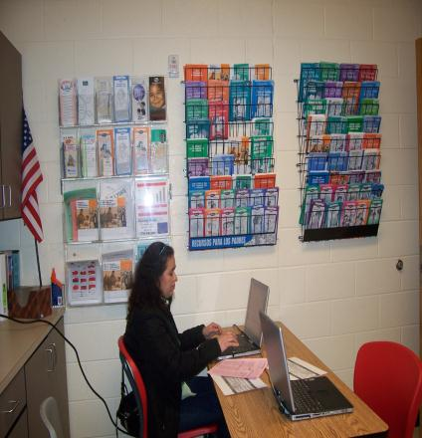
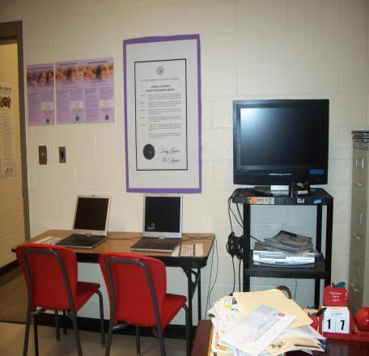
READ AND RISE CAN LEVERAGE AND SUPPORT OTHER PARENT RESOURCES

Slide 20
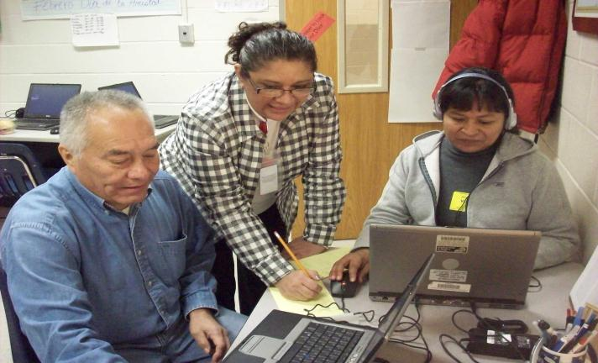
READ AND RISE INCREASES PARENTS CONFIDENCE TO ENGAGE THEIR FAMILIES WITH LITERACY

Slide 21
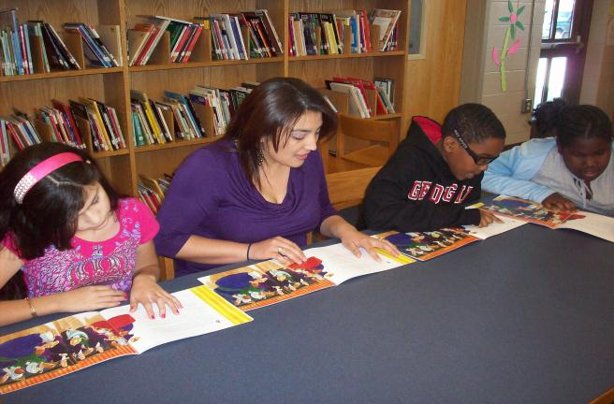
OUR SCHOOLS HAVE BECOME “COMMUNITY LITERACY CENTERS” AS A RESULT OF THE ON-GOING COLLABORATION.

Slide 22
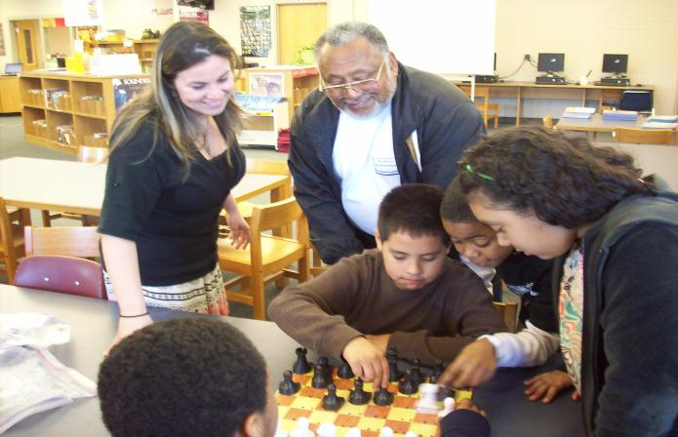
WHAT HAVE WE LEARNED? LITERACY SUPPORT MUST BE AN ENJOYABLE AND AFFIRMING EXPERIENCE.

Slide 23
Improved Collaboration to yield Outcomes for children
Director of Learning Supports serves on the Hall County Commission on Children and Families to share information and link resources.
School district coordinates with six college-universities in Professional Development School collaborations to promote literacy initiatives
Superintendent serves on the United Way Board of Directors.
Superintendent serves on the Chamber of Commerce Board of Directors, Economic Development Council, and Issues Committees.
Intergovernmental agreements with City of Gainesville Park and Recreation and Hall County Schools ( neighboring districts)
Grant collaborations with Boys and Girls Club, YMCA, Park and Recreation, Centerpoint Counseling and Mentorship Agency, City of Gainesville Transit System

Slide 24
OUTCOMES SPEAK FOR THE COMMUNITY-SCHOOL CONNECTION
Graduation rate has moved from 73.3 three years ago to 87.2 this year
More students achieving “Exceeding Expectations” on state testing than ever before and at every school
Disciplinary tribunals decreased by 27%
Increased family and community engagement: Successfully implementing Read and Rise to help bridge school-home-community connections.
More than 92% of participating parents reported an increase in supporting their children’s literacy development at home.

Slide 25
LEARNING SUPPORTS RESOURCE MAPPING: Group Discussion
In your district or organization…
What kinds of supports are you providing around family and community engagement and who are you offering them to ? (All families, Some families, Case By case)
Consider the following:
How valuable is the activity? (i.e. outcomes)
Are there gaps and/or areas of duplication?
What partners are currently involved? Who else might help you meet shared goals to ensure outcomes?

Slide 26
Our shared vision and mission…
Our students will think critically, act compassionately, work meaningfully, choose wisely, and live joyfully.
As ONE GAINESVILLE, we will inspire nurture, challenge, and prepare our students as we educate them to be successful in a 21st century global society.

